Slide 1

Process-based models II
Part IV

Slide 2
Population
dynamics
Space (& dispersal)
Biotic interactions
+
+
=
Metacommunity dynamics

Slide 3
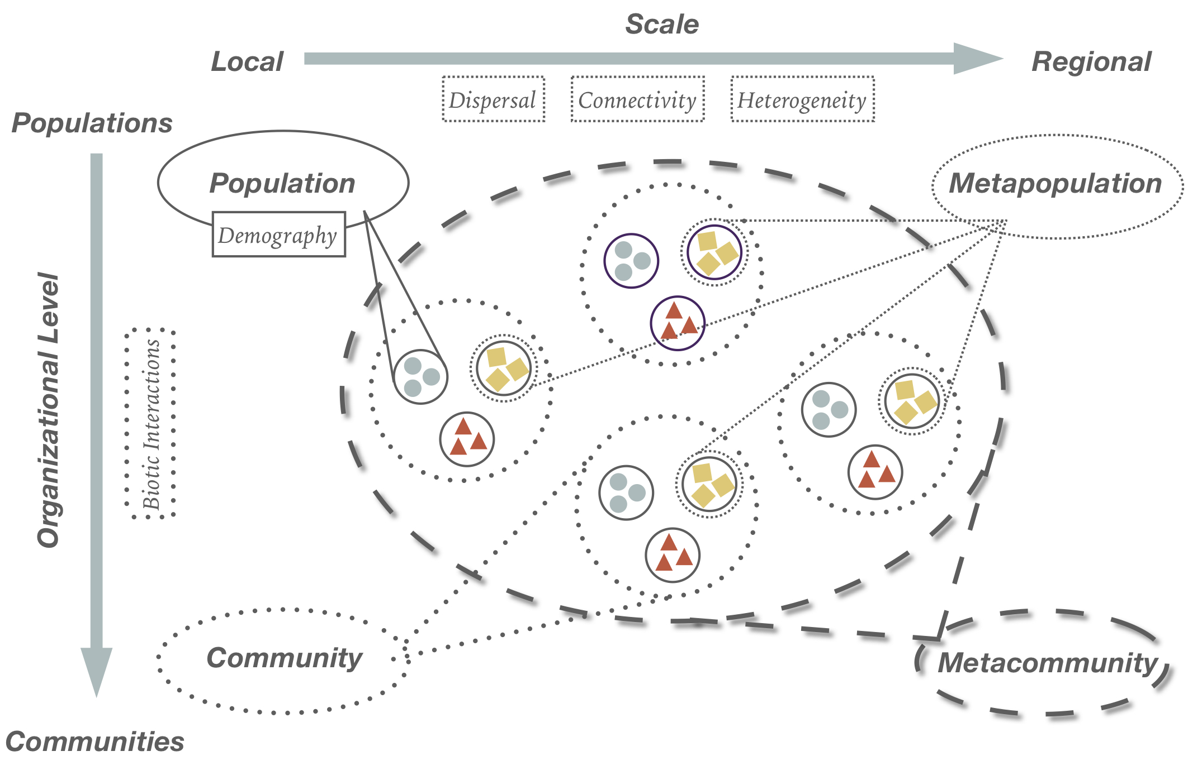
Chase et al. 2020 Ann NY Acad Sci

Slide 4
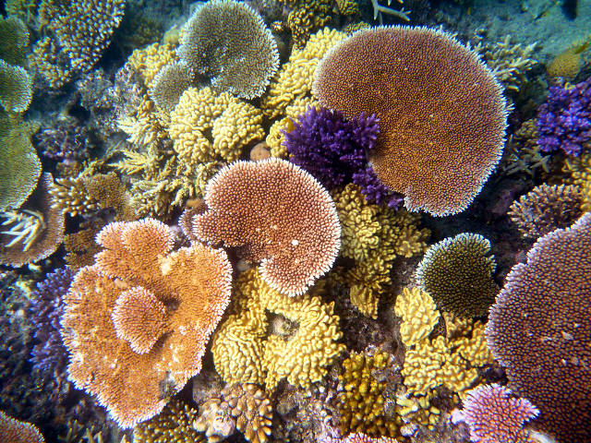
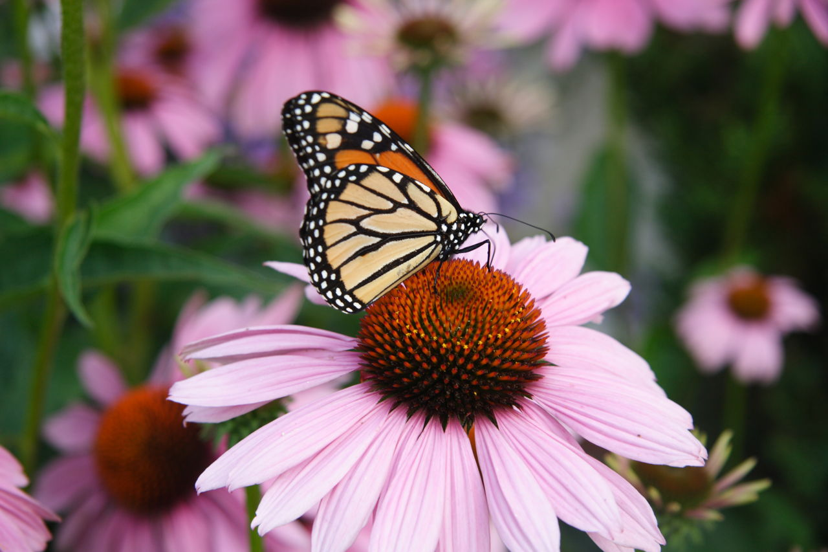
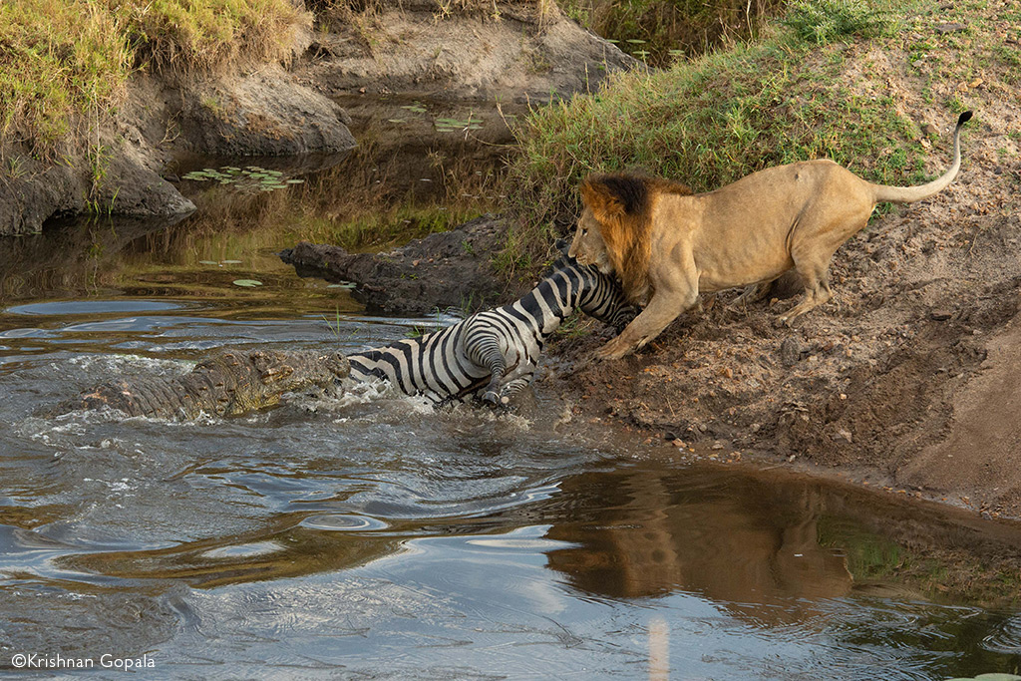
Biotic interactions
Intraspecific and interspecific
Competition
Predation
Herbivory
Symbiosis: mutualism (+,+),
commensalism (+,0), parasitism (+,-)

Slide 5
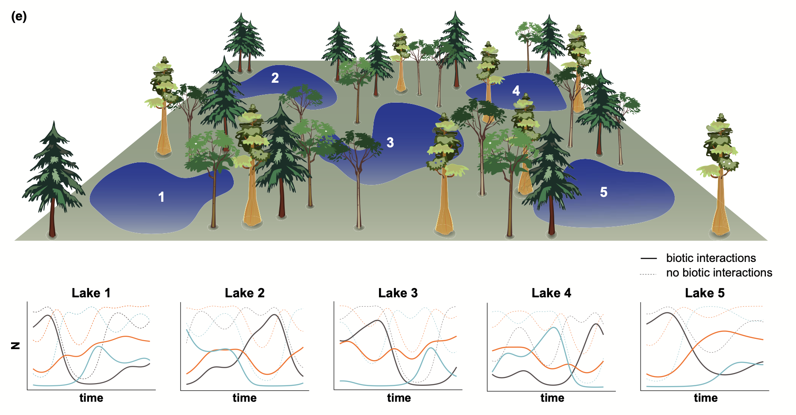
Thompson et al. 2020 Ecol Lett

Slide 6

Thompson et al. 2020 Ecol Lett

Slide 7

Thompson et al. 2020 Ecol Lett

Slide 8
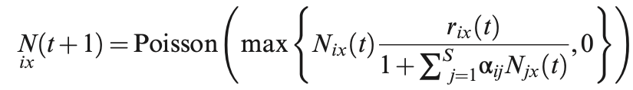
Thompson et al. 2020 Ecol Lett

Slide 9
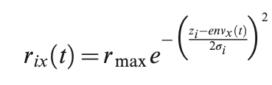
Thompson et al. 2020 Ecol Lett

Slide 10
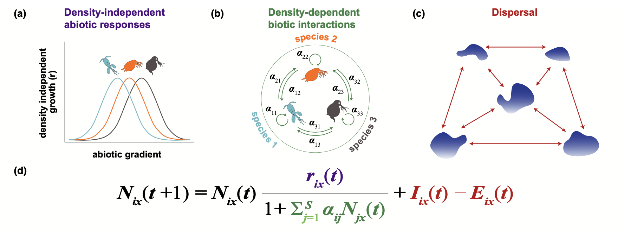
Thompson et al. 2020 Ecol Lett

Slide 11
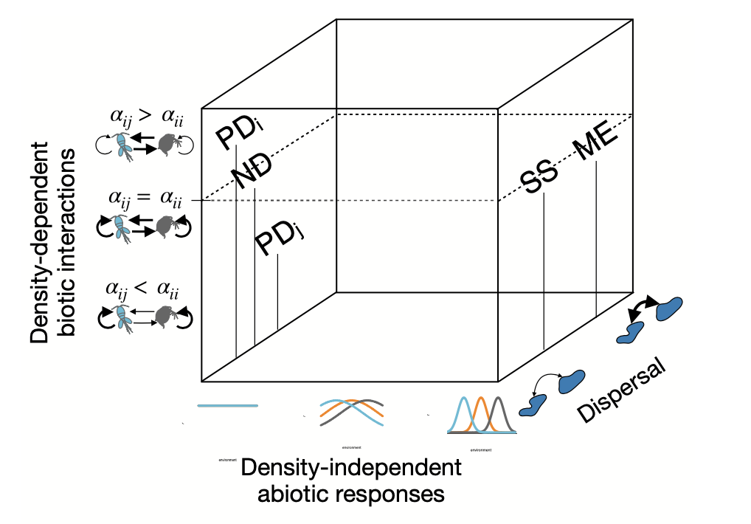
Computer exercises
Metacommunity dynamics

Slide 12
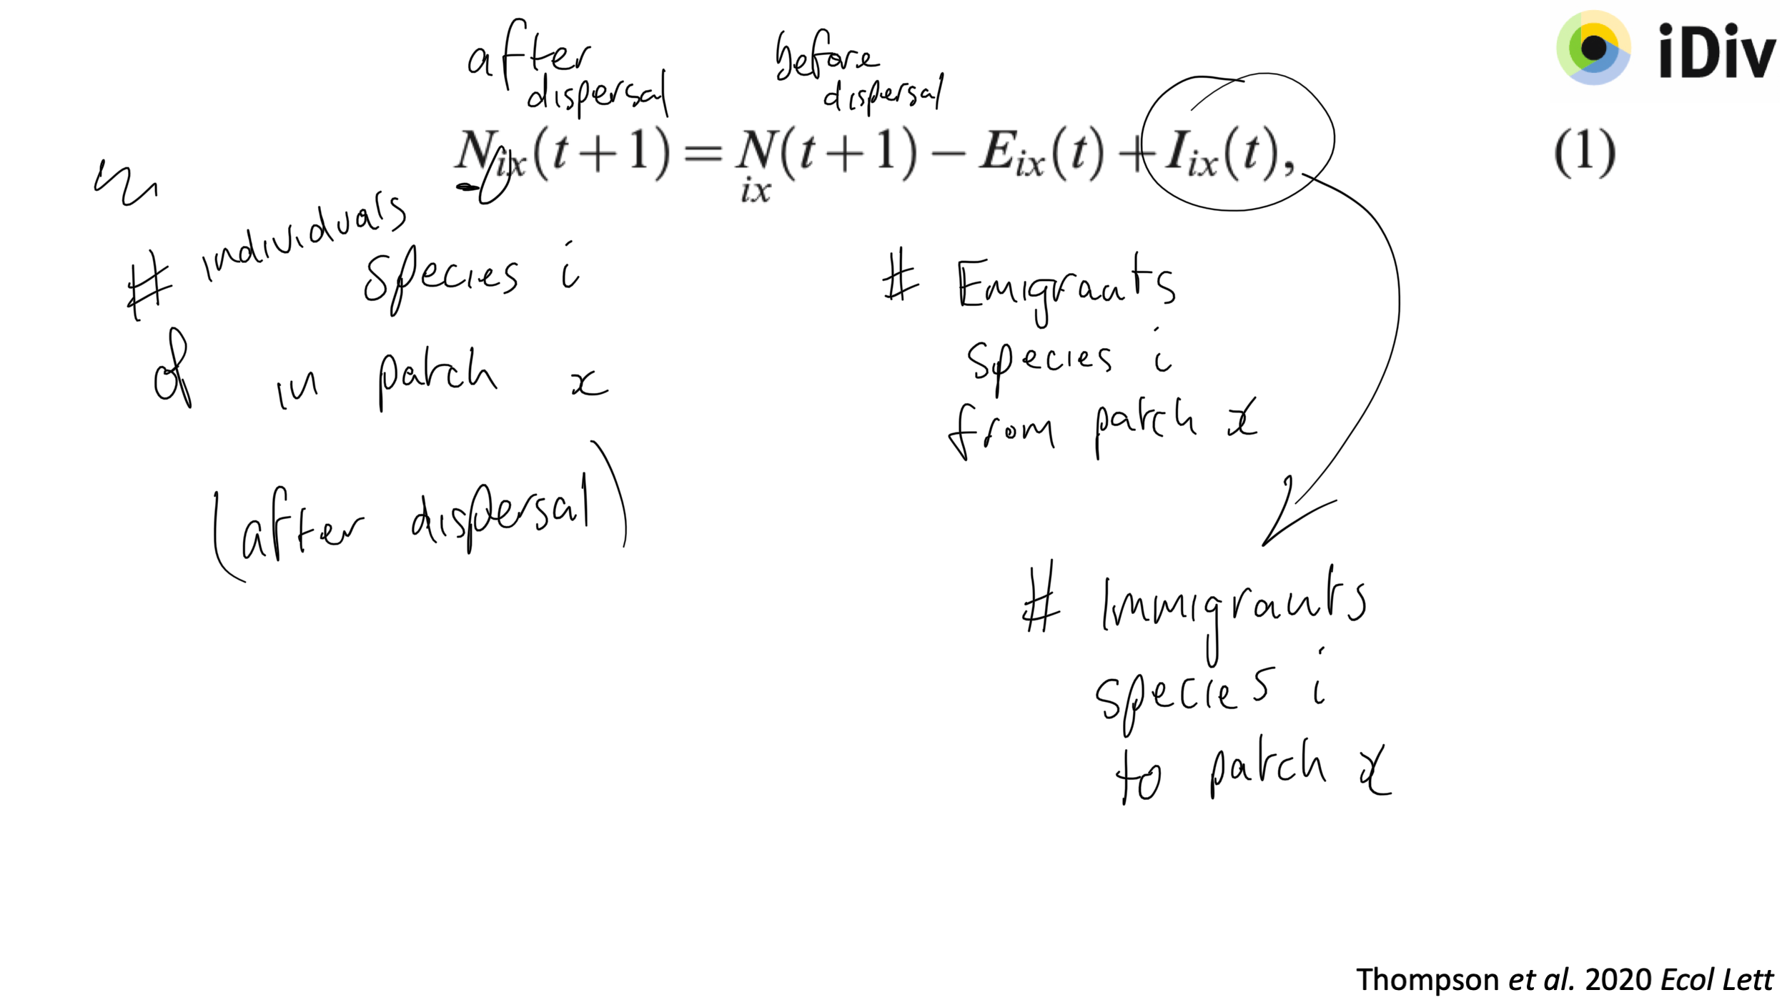
Thompson et al. 2020 Ecol Lett

Slide 13
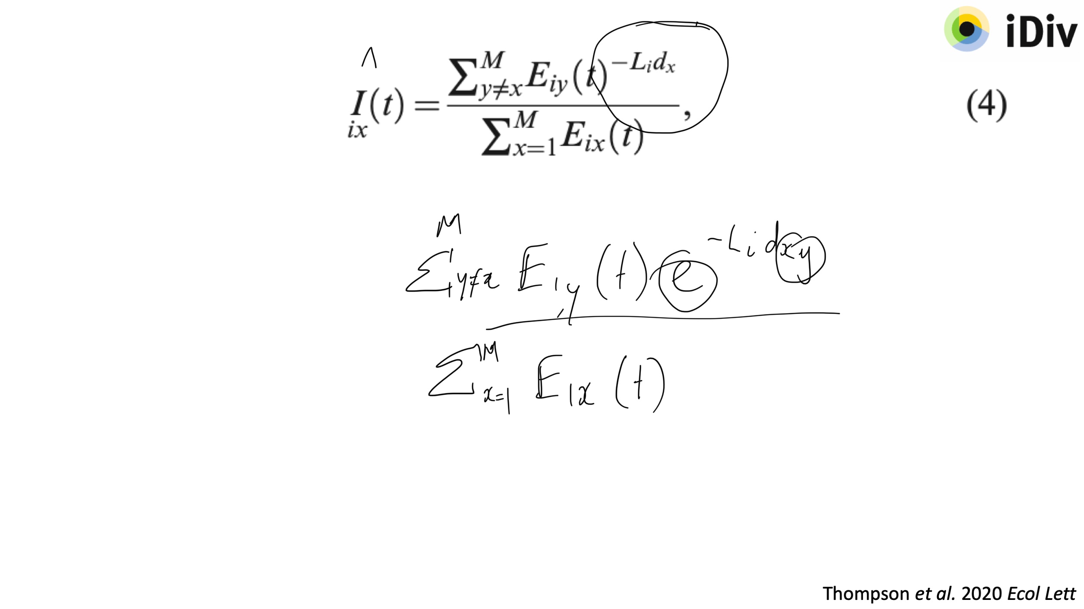
Thompson et al. 2020 Ecol Lett

Slide 14
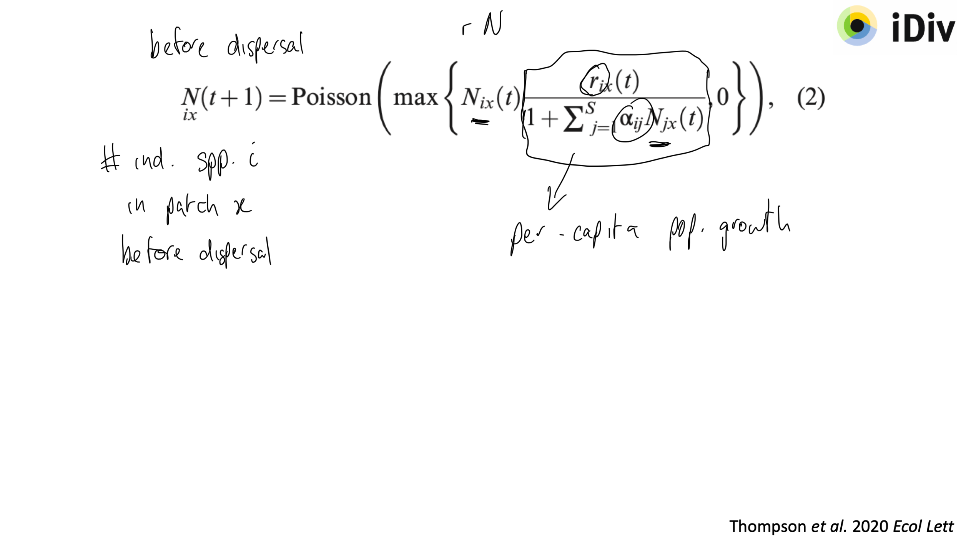
Thompson et al. 2020 Ecol Lett

Slide 15
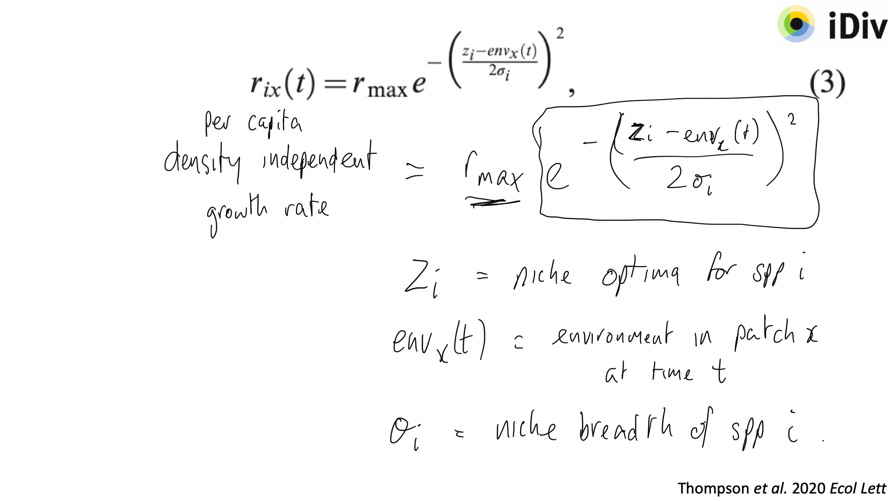
Thompson et al. 2020 Ecol Lett

